Slide 1
Penang Island vs Seberang Perai
Amy TSE

Slide 2
Problem Description/ Background
Penang is a Malaysian state located on the northwest coast of Peninsular Malaysia, by the Malacca Strait. It has two parts: Penang Island, where the capital city, George Town, is located, and Seberang Perai on the Malay Peninsula.
Housing has long been a problem for Penang residents. Rising prices has inevitably encourage movement of residents from the Island (population density of 2,465.47/km2) to the Mainland (Seberang Perai), which has a population density of 1,089.5/km2, less than half of that in Penang Island, and land area of 2.6 times larger thus making the housing there more affordable.
The two parts of Penang are not entirely alike. We will be comparing the similarities and dissimilarities between the neighborhoods in these two parts of Penang, and decide the best location to move to if you are coming from Penang Island.

Slide 3

Data Description
Districts and neighborhoods in Penang from https://www.penang.gov.my and https://en.wikipedia.org/wiki/Category:Districts_of_Penang
Latitude and Longitude of the neighborhoods using Python geocoder
Venues nearby using Foursquare API
A separate utf-8 csv to structure District and Neighborhoods

Slide 4
Methodology/ Analysis
Using
Using neighborhood clustering to find similarities and dissimilarities between Penang Island and Seberang Perai
Using
Using neighborhood clustering to decide best area to move to in Seberang Perai from selected neighborhood in Penang Island for more affordable housing that are most adaptable.

Slide 5
Penang Districts
Penang is made out of 5 district, 2 in Penang Island and 3 in Seberang Perai, Malay Peninsular
Penang Island Districts:
Northeast Penang Island
Southwest Penang Island
Seberang Perai Districts
North Seberang Perai
Central Seberang Perai
South Seberang Pera

Slide 6
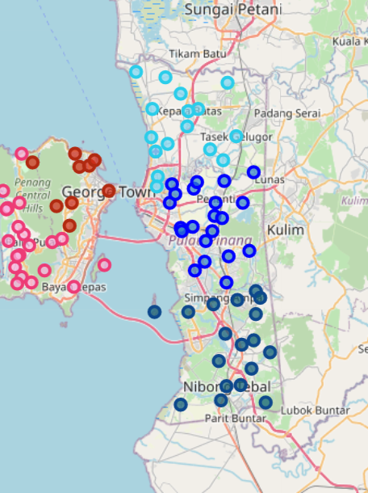
Penang Neighborhoods
Red - Northeast Penang Island
Pink - Southwest Penang Island
Light Blue - North Seberang Perai
Blue - Central Seberang Perai
Dark Blue - South Seberang Perai

Slide 7
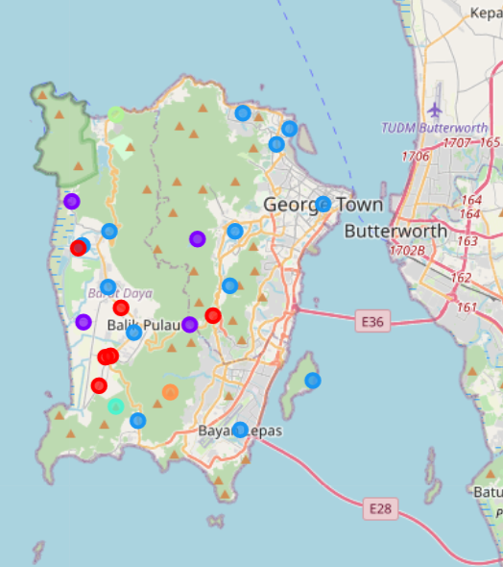
Cluster top 6 venues for each neighborhoods in Penang Island with kmeans of 6
Penang Island is divided into 6 clusters with the biggest clusters being cluster 3 and 1. Their make ups from biggest to smallest:
Cluster 3- Mix Asian/ Dessert places
Cluster 1 - Malay/ Track and Field
Cluster 2 - Chinese/ Seafood/ Nature
Cluster 4,5,6 - etc

Slide 8
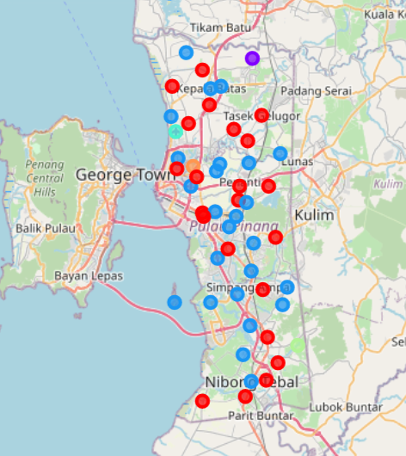
Cluster top 6 venues for each neighborhoods in Seberang Perai with kmeans of 6
Seberang Perai is divided into 6 clusters with the biggest clusters being cluster 3 and 1. Their make ups from biggest to smallest:
Cluster 3 - Mix Asian/ Dessert places
Cluster 1 - Malay/ Outdoors
Cluster 2,4,5,6 - etc

Slide 9
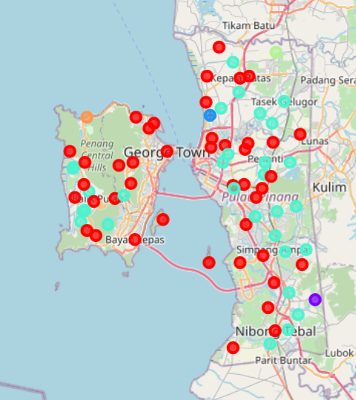
Cluster top 6 venues for each neighborhoods in Penang Combined with kmeans of 6
As a whole, Penang has 6 clusters with the biggest cluster in cluster 1 and 4. The general theme of the clusters from biggest to smallest are:
Cluster 1 - Mix Asian
Cluster 4 - Malay/ Outdoors
Cluster 2,3,5,6 - etc

Slide 10
Results and Discussion
Similarities:
Both have mix cultural area with dessert and entertainment places
Both have the biggest cluster in diverse cultured neighborhoods
Dissimilarities:
Penang Island has a Chinese seafood majority cluster which is not seen in Seberang Perai

Slide 11
Conclusion
Based on the Penang clusters, a young couple in George Town, one of the 17 neighborhoods in Penang Island can move to 26 neighborhoods in Seberang Perai within the same cluster, specifically Bandar Perda and Jalan Betek in Central Seberang Perai which contains 2 of its top 3 venues.
Similarly, someone from Titi Teras, one of the 9 neighborhoods in Penang Island, will find it easier to blend into the surrounding of the 22 neighborhoods in Seberang Perai, specifically Kubang Semang, which has 3 of its top 4 venues.
Overall, the accuracy and suitability of Penang Island to Seberang Perai migration depends heavily on choices of food because Foursquare API mostly provides food related venues, especially in Asia region.

